Slide 1
Publishing MARC21 records to BIBFRAME Bibliographic format and RDA RDF format
Via the General Publishing Profile
Yoel Kortick | May 2026

Slide 2
Agenda
Introduction
The sample records to publish
Creating the publishing profiles
The results for BIBFRAME bibliographic format
The results for RDA/RDF format

Slide 3

Introduction

Slide 4
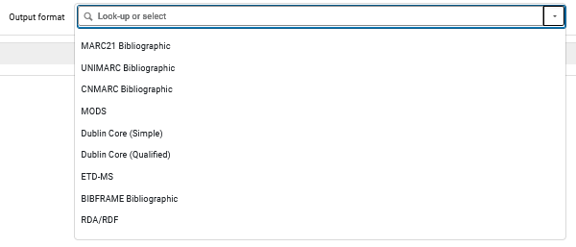
Introduction
Via the general publishing profile, it is possible to publish records in a variety of formats.
This includes, among others:
  BIBFRAME Bibliographic
  RDA/RDF

Slide 5
Introduction
BIBFRAME Bibliographic ¹
  Is a Linked Data vocabulary developed by the Library of Congress to “eventually” replace MARC as the bibliographic data exchange standard
  It models library resources as a graph of interconnected entities (Work, Instance, Item) that can be published to the open web.
  It enables libraries to expose their collections as machine-readable, interoperable data discoverable beyond the OPAC.
¹ The Library of Congress BIBFRAME pages at https://www.loc.gov/bibframe/

Slide 6
Introduction
RDA RDF ²
  Is the Resource Description and Access cataloging standard expressed as an RDF vocabulary (via the RDA Registry)
  It provides a formal, namespace-grounded set of elements and value vocabularies that libraries use to describe resources in a way that is both
    human-intelligible
    Linked Data-compatible
  It often serves as the semantic backbone for BIBFRAME implementations.
² The RDA Registry at http://www.rdaregistry.info/

Slide 7
Introduction
Some of the reasons an institution may want to publish their records in BIBFRAME Bibliographic format are:
  Web visibility and discoverability — Publishing in BIBFRAME exposes the library's collections as Linked Open Data on the web, making resources discoverable by search engines and external applications beyond the library's own discovery system.
  Interoperability across institutions — BIBFRAME's entity-based graph model allows bibliographic data to be shared and reused across institutions and systems in a way that flat MARC records cannot support, reducing redundant cataloging effort.
In both of the above cases an external system would take the file from Alma and ingest and process the file

Slide 8
Introduction
Some of the reasons an institution may want to publish their records in RDA/RDF format are:
  Semantic precision and vocabulary alignment — RDA RDF provides a formally defined, namespace-grounded element set that maps cleanly to the conceptual models (LRM) underlying modern cataloging, making the library's data unambiguous and reusable by other Linked Data consumers.
  Complementarity with BIBFRAME — Since RDA RDF serves as the preferred descriptive vocabulary within BIBFRAME descriptions (supplying property and value semantics), publishing in RDA RDF positions the library's data to integrate naturally into the broader BIBFRAME/Linked Data ecosystem that the academic library community is converging toward.
    This reason also highlights why the two formats are often discussed together rather than as competing alternatives — they are designed to work in concert.

Slide 9
Introduction
Note that this presentation will not relate to the use of the Linked Data Enrichment Configuration.
All options for the Linked Data Enrichment (rows in the related tables of the Linked Data Enrichment Configuration) will be disabled.
An in-depth explanation and live demo of the Linked Data Enrichment Configuration can be seen at Linked Data Enrichment.pptx

Slide 10
The sample records to publish

Slide 11
The sample records to publish
There are three sample records to publish:
  Food culture and literary imagination in early modern Italy (99619961700121)
  Treasured Polish songs (99603910800121)
  Accounts of "first wave" feminism in Germany by German feminists (99603910400121)

Slide 12
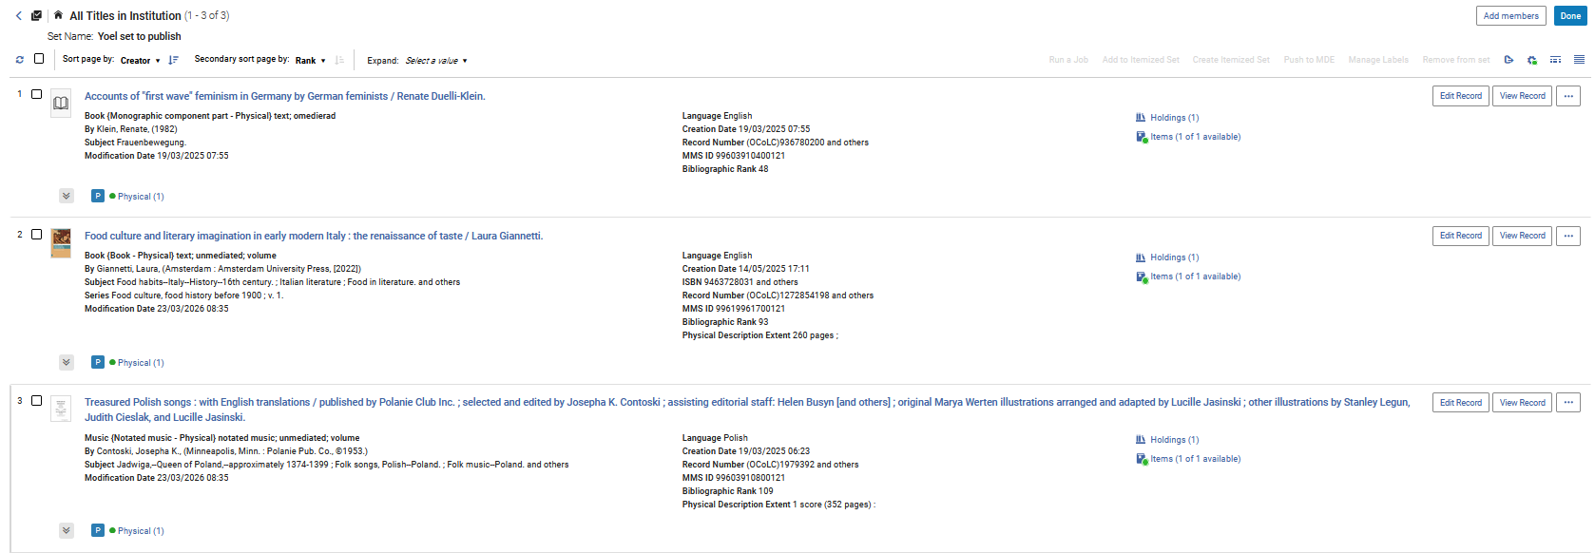
The sample records to publish
The three records are in a set called “Yoel set to publish”

Slide 13
Creating the publishing profiles

Slide 14


Creating the publishing profiles
We will now create the publishing profiles at “Resources > Publishing > Publishing Profiles > Add Profile > General Profile

Slide 15
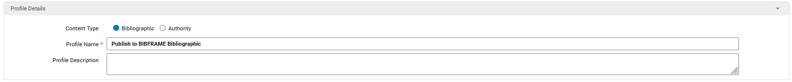
Creating the publishing profiles
For the BIBFRAME Bibliographic profile - in the “Profile Details” section we will
  Call the first profile “Publish to BIBFRAME Bibliographic”
  Define that it will have content type “Bibliographic”

Slide 16
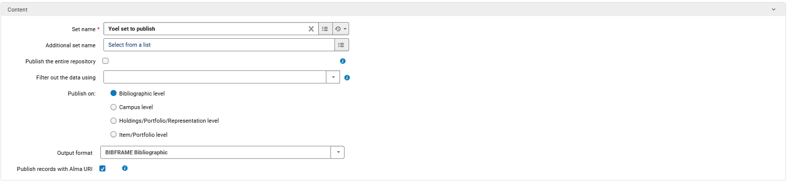
Creating the publishing profiles
For the BIBFRAME Bibliographic profile - in the “Content” section we will
  Use the set we already saw called “Yoel set to publish”
  Define that it will publish on “Bibliographic Level”
  Have output format “BIBFRAME Bibliographic” and check the box “Publish records with Alma URI” (it is by default checked when choosing format “BIBFRAME Bibliographic”)

Slide 17
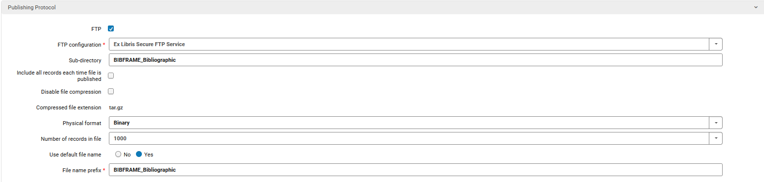
Creating the publishing profiles
For the BIBFRAME Bibliographic profile - in the “Publishing Protocol” section we will
  Publish to FTP using the Ex Libris Secure FTP Service
  Have output file go to directory “BIBFRAME_Bibliographic”
  Have the file get prefix “BIBFRAME_Bibliographic”

Slide 18
Creating the publishing profiles
For the BIBFRAME Bibliographic profile - in the “Bibliographic Normalization” section we will
  Check the box “Linked Data Enrichment” (it is by default checked when choosing format “BIBFRAME Bibliographic”)

Slide 19
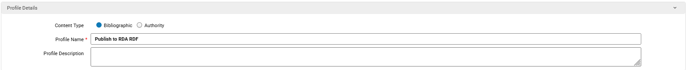
Creating the publishing profiles
For the RDA RDF profile - in the “Profile Details” section we will
  Call the first profile “Publish to RDA RDF”
  Define that it will have content type “Bibliographic”

Slide 20
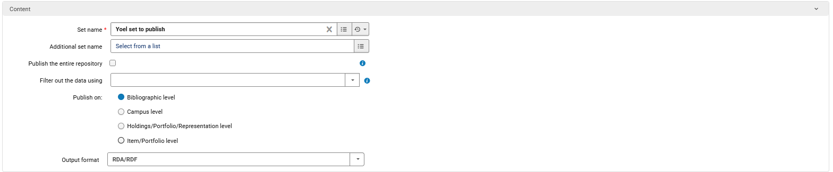
Creating the publishing profiles
For the RDA RDF profile - in the “Content” section we will
  Use the set we already saw called “Yoel set to publish”
  Define that it will publish on “Bibliographic Level”
  Have output format “RDA/RDF”

Slide 21
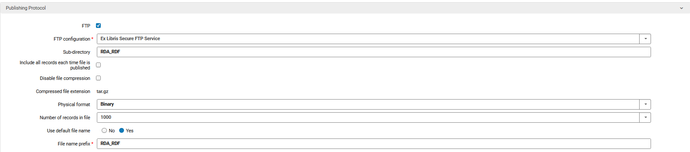
Creating the publishing profiles
For the RDA RDF profile - in the “Publishing Protocol” section we will
  Publish to FTP using the Ex Libris Secure FTP Service
  Have output file go to directory “RDA_RDF”
  Have the file get prefix “RDA_RDF”

Slide 22
Creating the publishing profiles
For the RDA RDF profile - in the “Bibliographic Normalization” section we will
  Check the box “Linked Data Enrichment” (it is by default checked when choosing format “RDA/RDF”)

Slide 23
Creating the publishing profiles
Both publishing profiles exist

Slide 24
The results for BIBFRAME bibliographic format

Slide 25
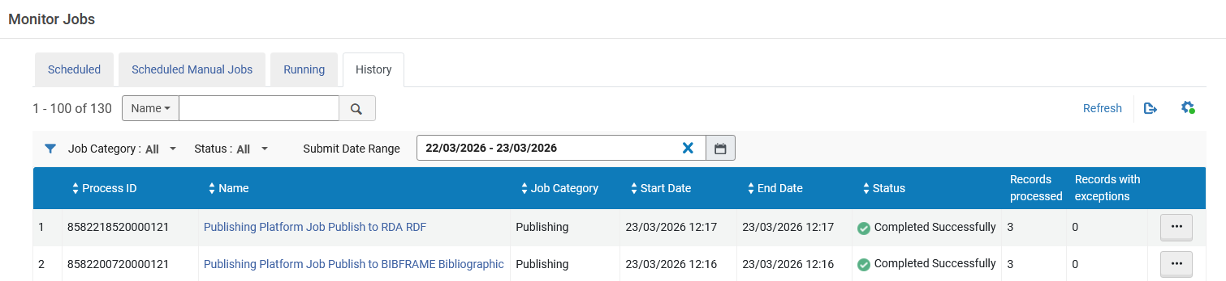
The results for BIBFRAME bibliographic format
The job completes

Slide 26
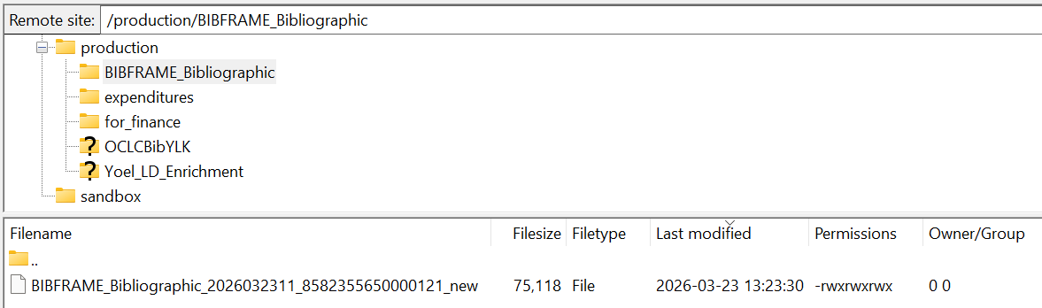
The results for BIBFRAME bibliographic format
The file in on the FTP server in the directory we specified with the prefix we specified

Slide 27
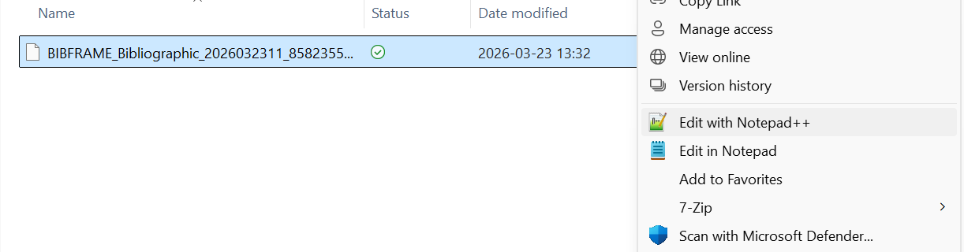
The results for BIBFRAME bibliographic format
The file has been transferred to the PC and we will open and view it
We will view the file in Notepad ++

Slide 28
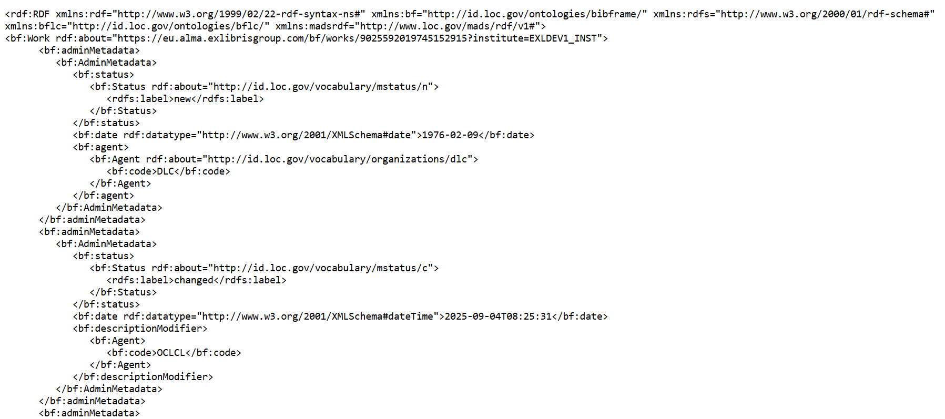
The results for BIBFRAME bibliographic format
Here is the beginning of the file

Slide 29
The results for BIBFRAME bibliographic format
The file contains three BIBFRAME works and three BIBFRAME instances
Beginning of first Work in the file
Beginning of second Work in the file
Beginning of third Work in the file

Slide 30
The results for BIBFRAME bibliographic format
The file contains three BIBFRAME works and three BIBFRAME instances
Beginning of first Instance in the file
Beginning of second Instance in the file
Beginning of third Instance in the file

Slide 31
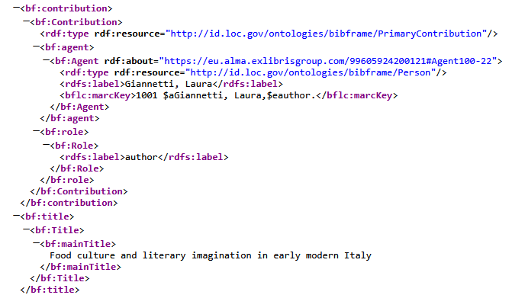
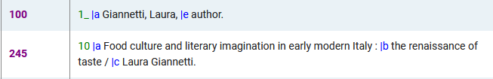
The results for BIBFRAME bibliographic format
Here for example is the author and title of “Food culture and literary imagination in early modern Italy” in both the published BIBFRAME Work and in the MARC21 record.

Slide 32
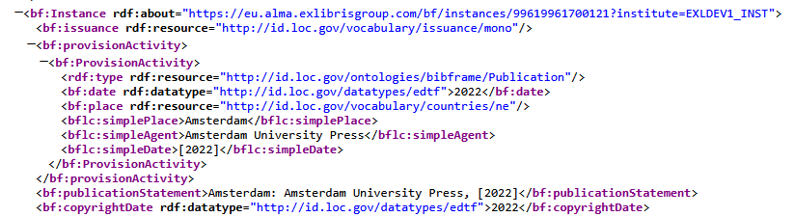
The results for BIBFRAME bibliographic format
Here for example is the publisher of “Food culture and literary imagination in early modern Italy” in both the published BIBFRAME Instance and in the MARC21 record.

Slide 33
The results for RDA/RDF format

Slide 34
The results for RDA/RDF format
The job completes

Slide 35
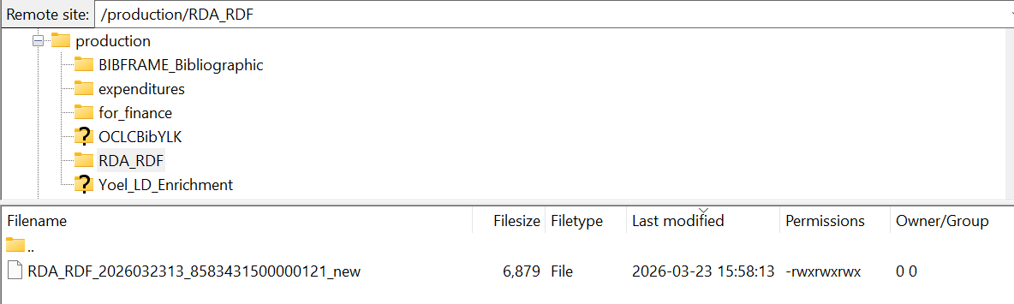
The results for RDA/RDF format
The file in on the FTP server in the directory we specified with the prefix we specified

Slide 36
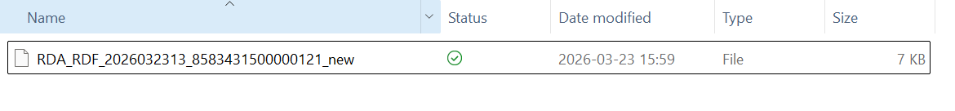
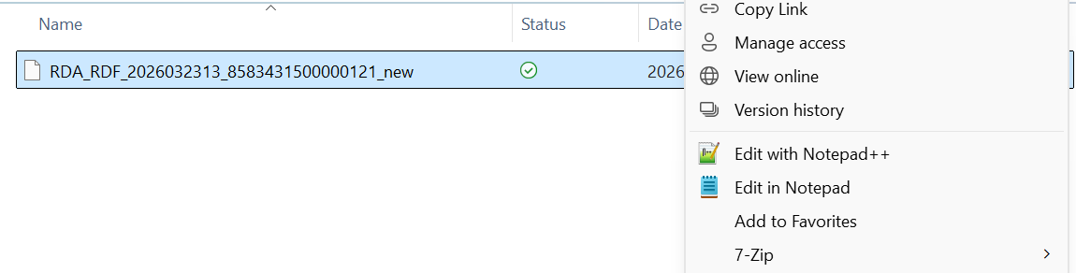
The results for RDA/RDF format
The file has been transferred to the PC and we will open and view it
We will view the file in Notepad ++

Slide 37
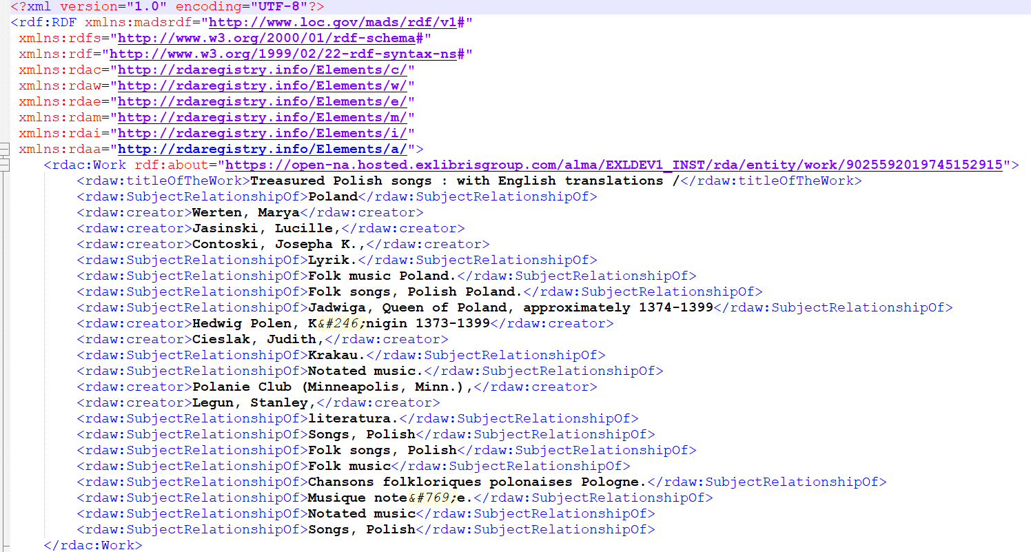
The results for RDA/RDF format
Here is the beginning of the file

Slide 38
The results for RDA/RDF format
The file of the results for the RDA/RDF format of the general publishing profile contains the following for each record:
  Work
  Expression
  Manifestation
We will now look at each of these for title “Treasured Polish songs : with English translations“

Slide 39
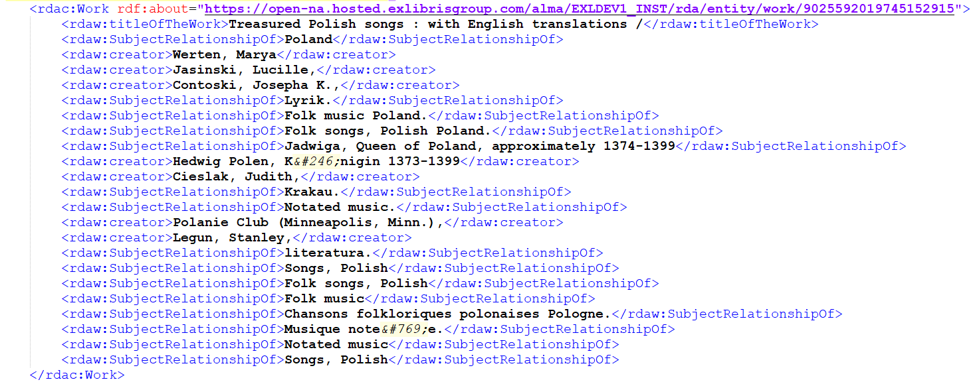
The results for RDA/RDF format
Here is the Work

Slide 40
The results for RDA/RDF format
Here is the Expression
Here is the Manifestation

Slide 41
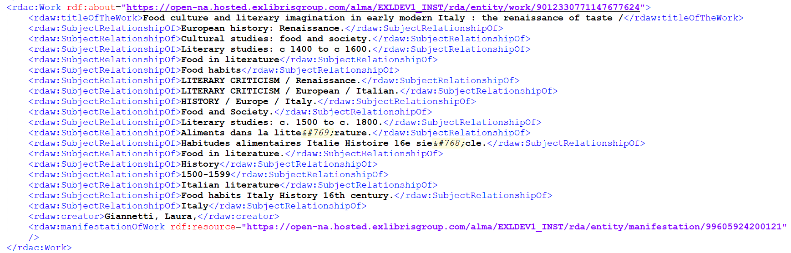
The results for RDA/RDF format
Here for example is the author and title of “Food culture and literary imagination in early modern Italy” in both the published RDA/RDF format Work and in the MARC21 record.

Slide 42
Thank You

